Slide 1
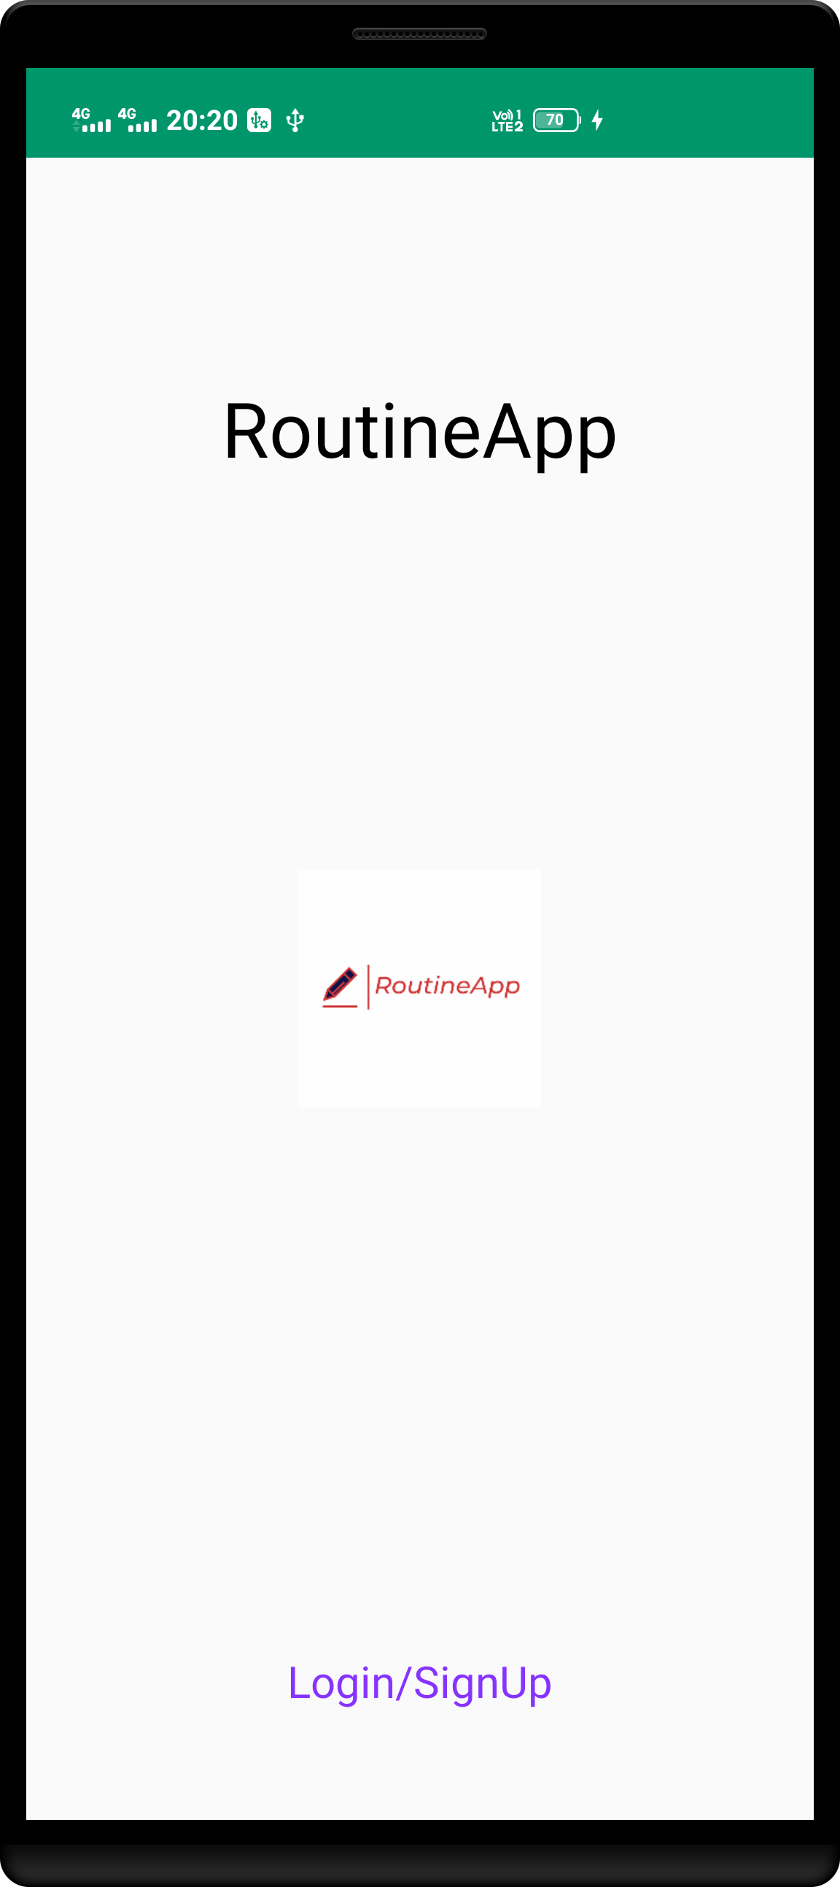
User can login using their email or Gmail id.
Can signup also if he or she is new user.
App Name
App Logo
Login signup button

Slide 2
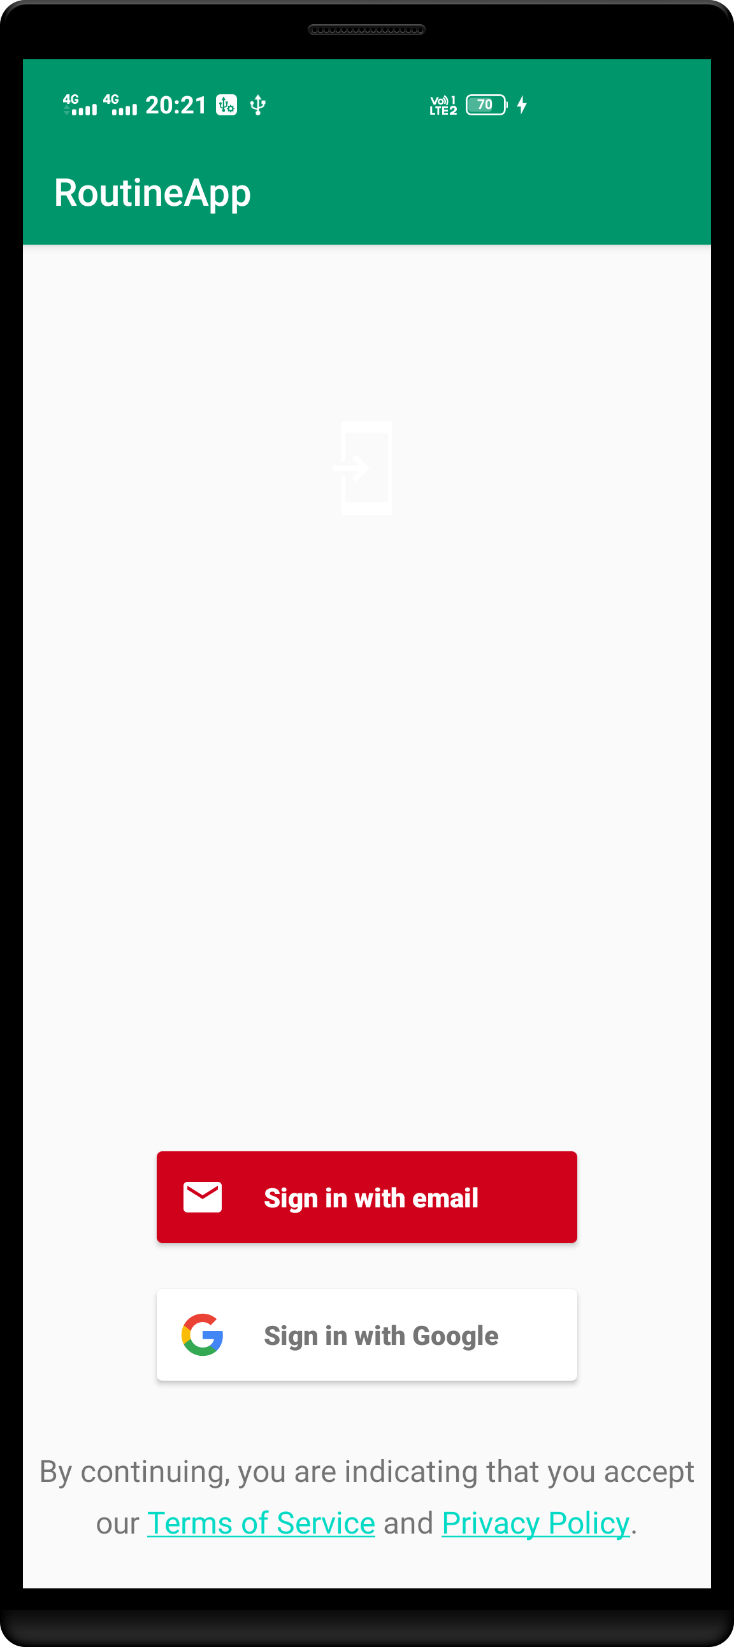
During login user password is not stored in plain text it cant be read by even member having access to RoutineApp database.
Sign in button for login using Email account.
Sign in button for login using Gmail account.

Slide 3
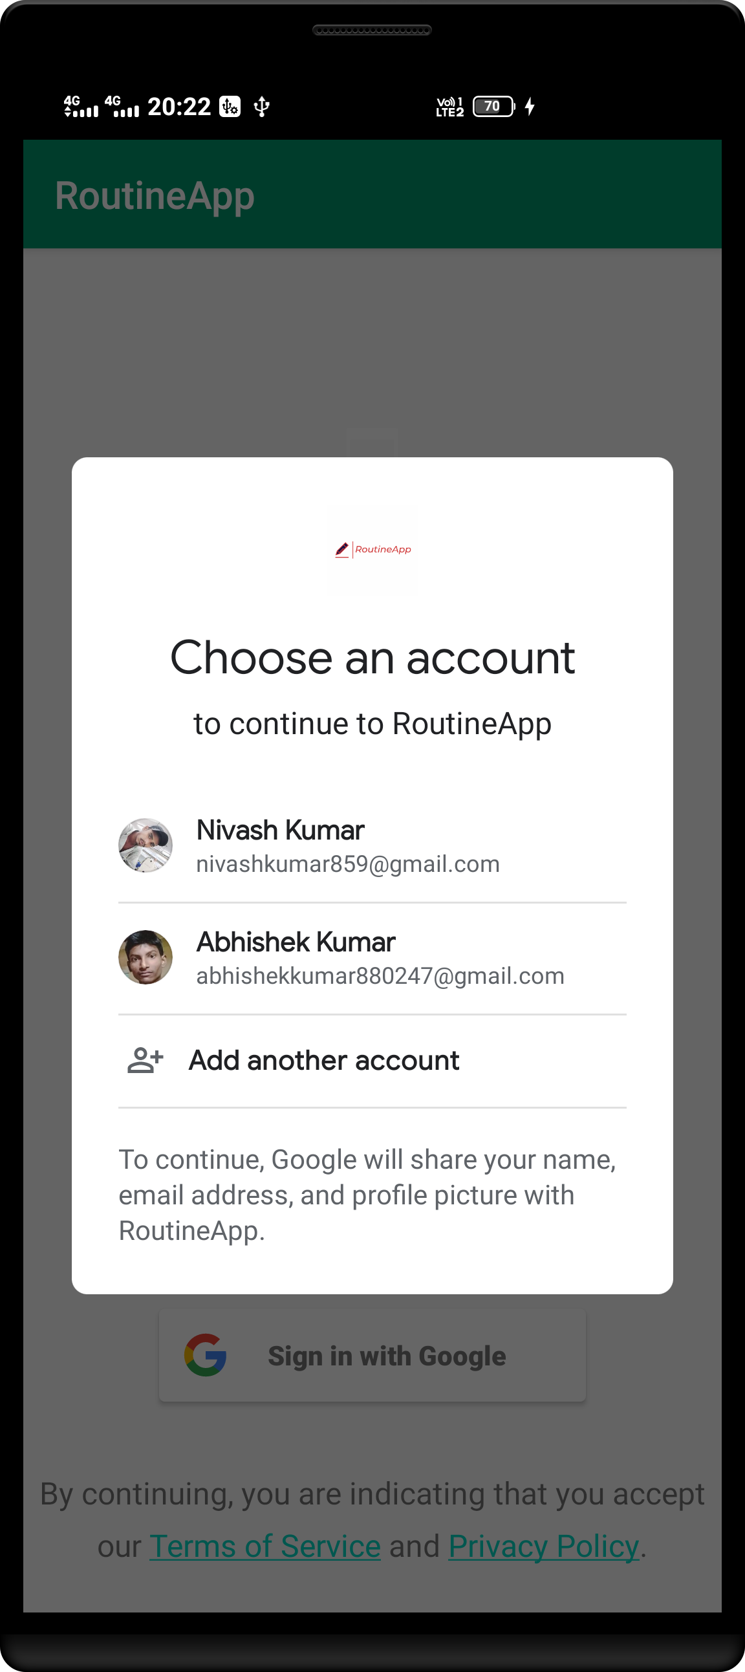
Login page to select Gmail account if having more than 1 Gmail account.

Slide 4
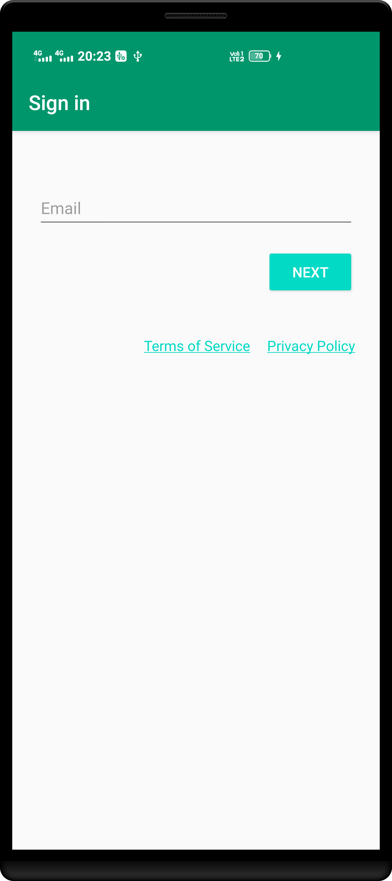
Confirm to use entered email id.
Email input box
T&C of routine app

Slide 5
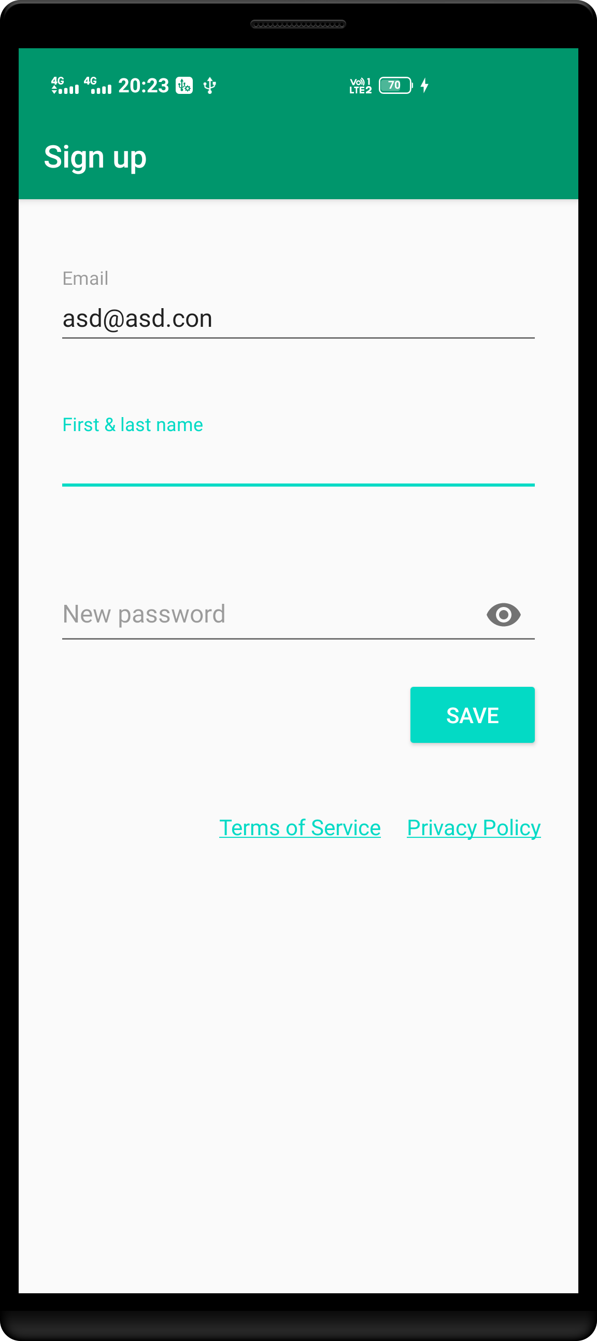
If user are entering new email id then this screen will be displayed.
After confirmation all of three fields user (new user) will get a welcome notification .

Slide 6
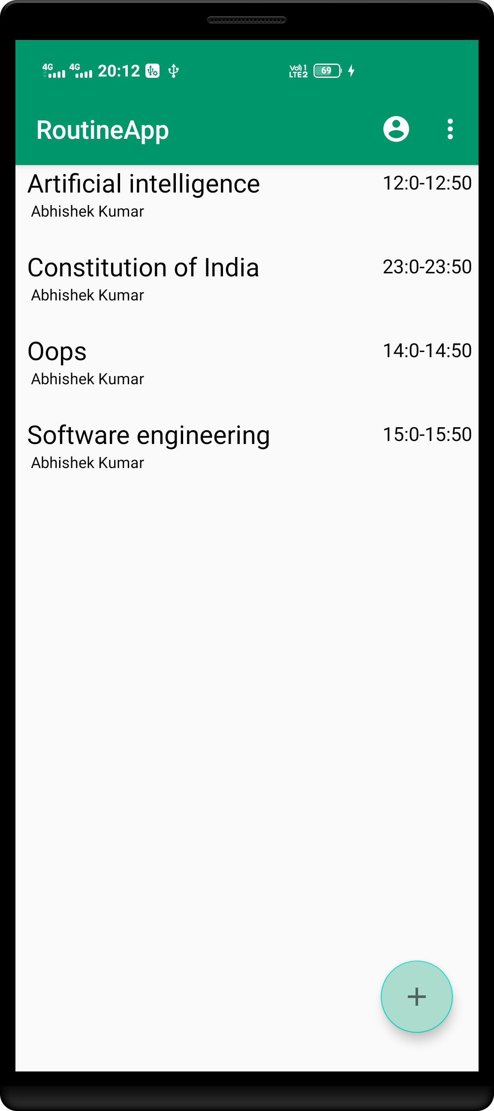
On clicking on each subject user need to verify password provided by class admin at least once if verified then no need to verify password any more.
Teacher Name
All subjects on current day on selected year and branch.
Menu options
Time when class will happen.
Button to add new subject

Slide 7
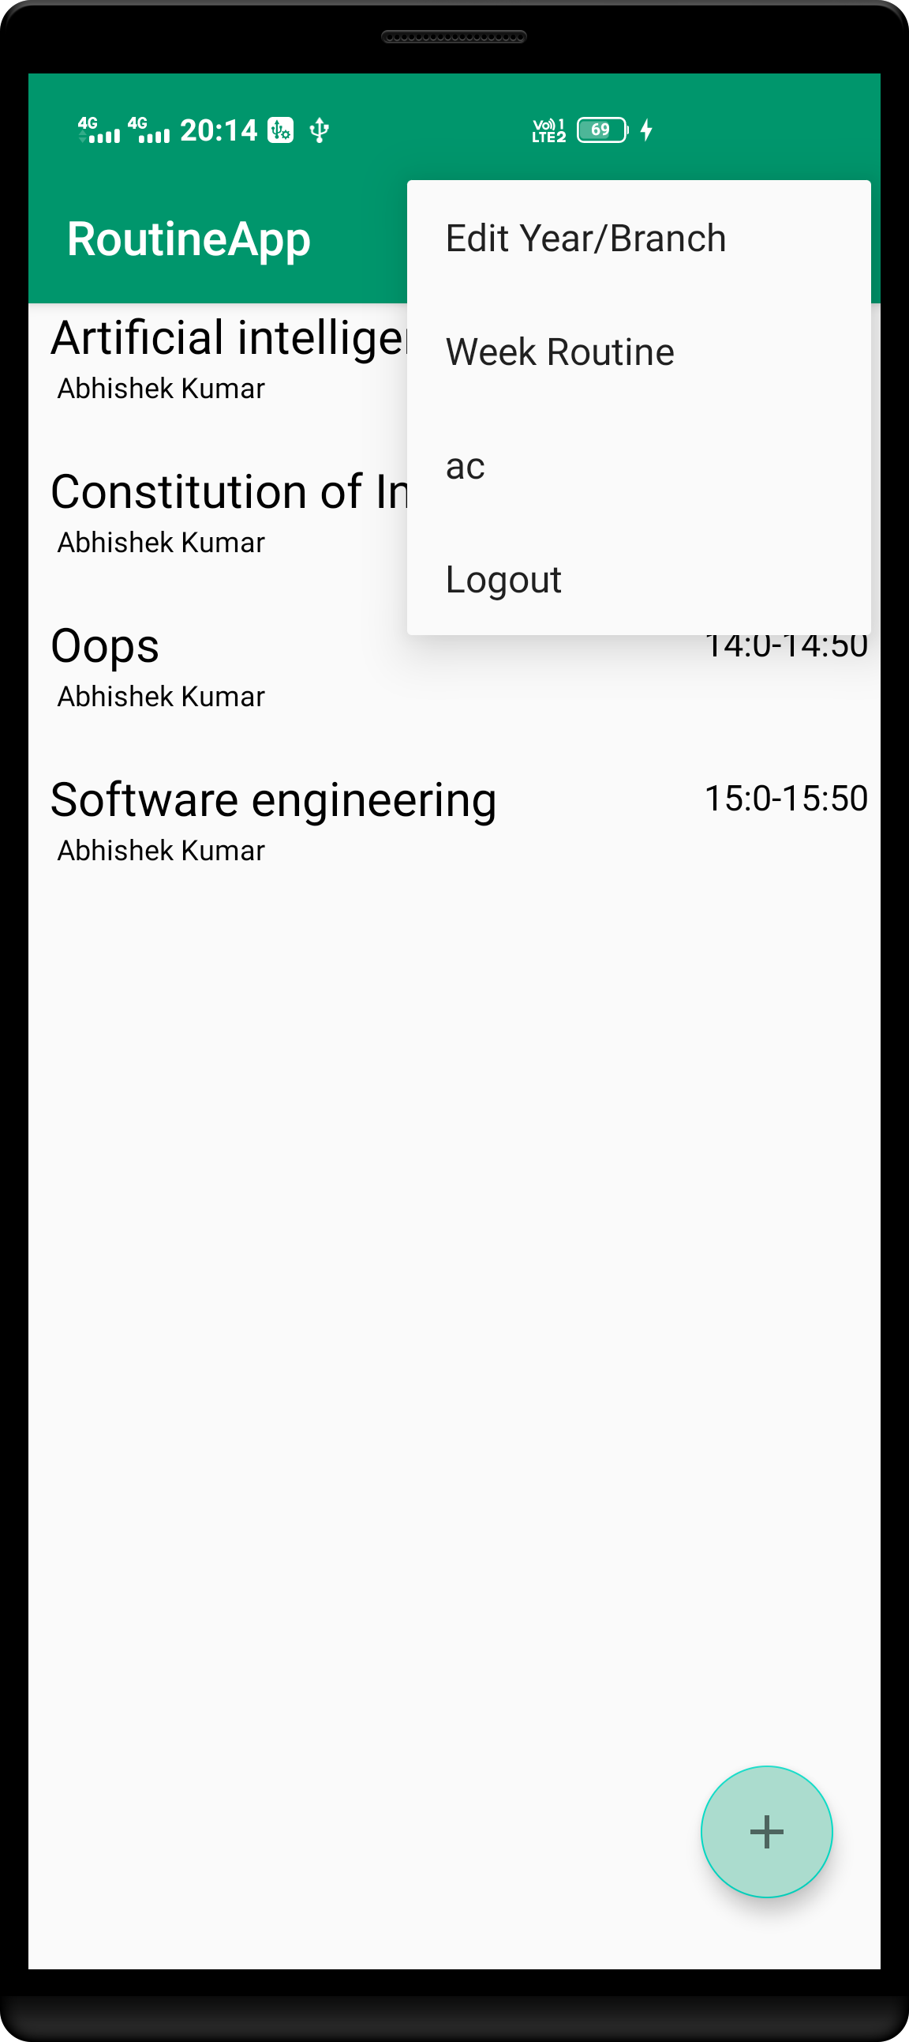
Class preference tab
Check whole week routine
Logout button

Slide 8
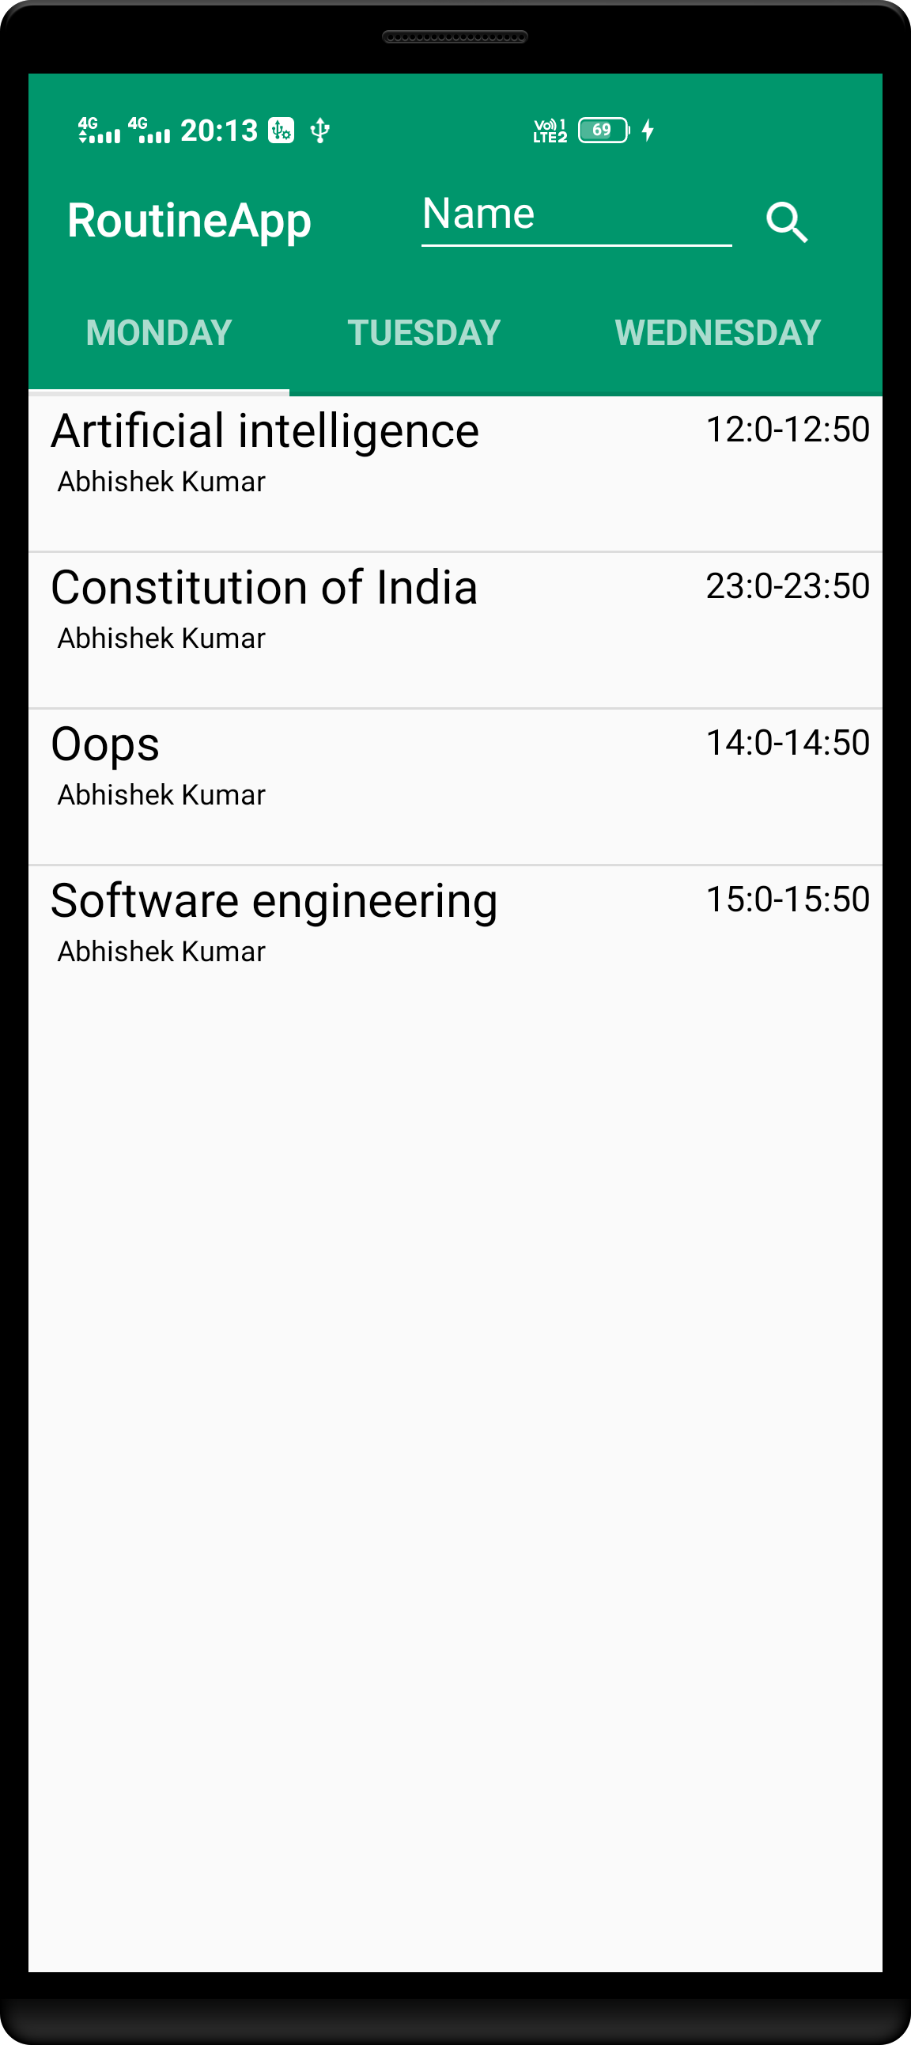
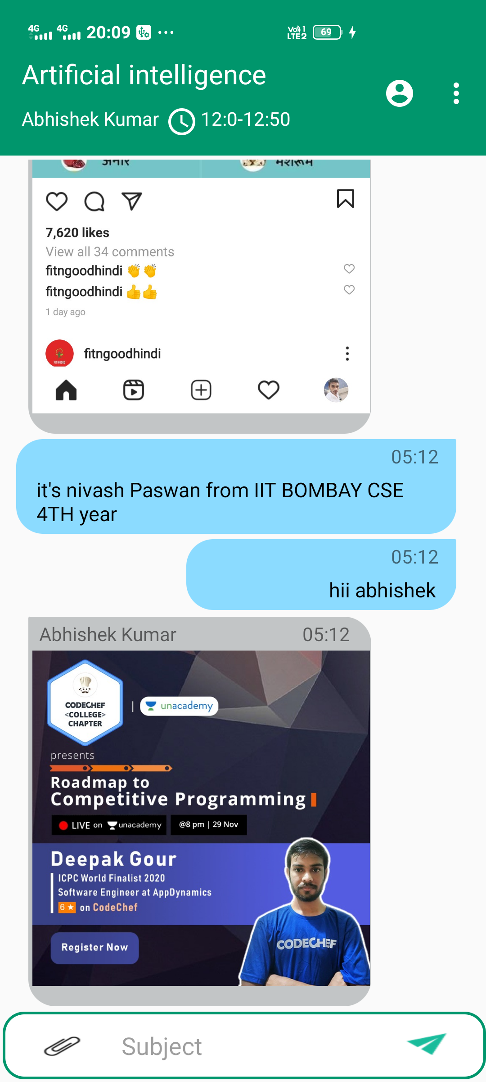
Whole week routine.
Image attachment
Text chat input box
Chat send button

Slide 9
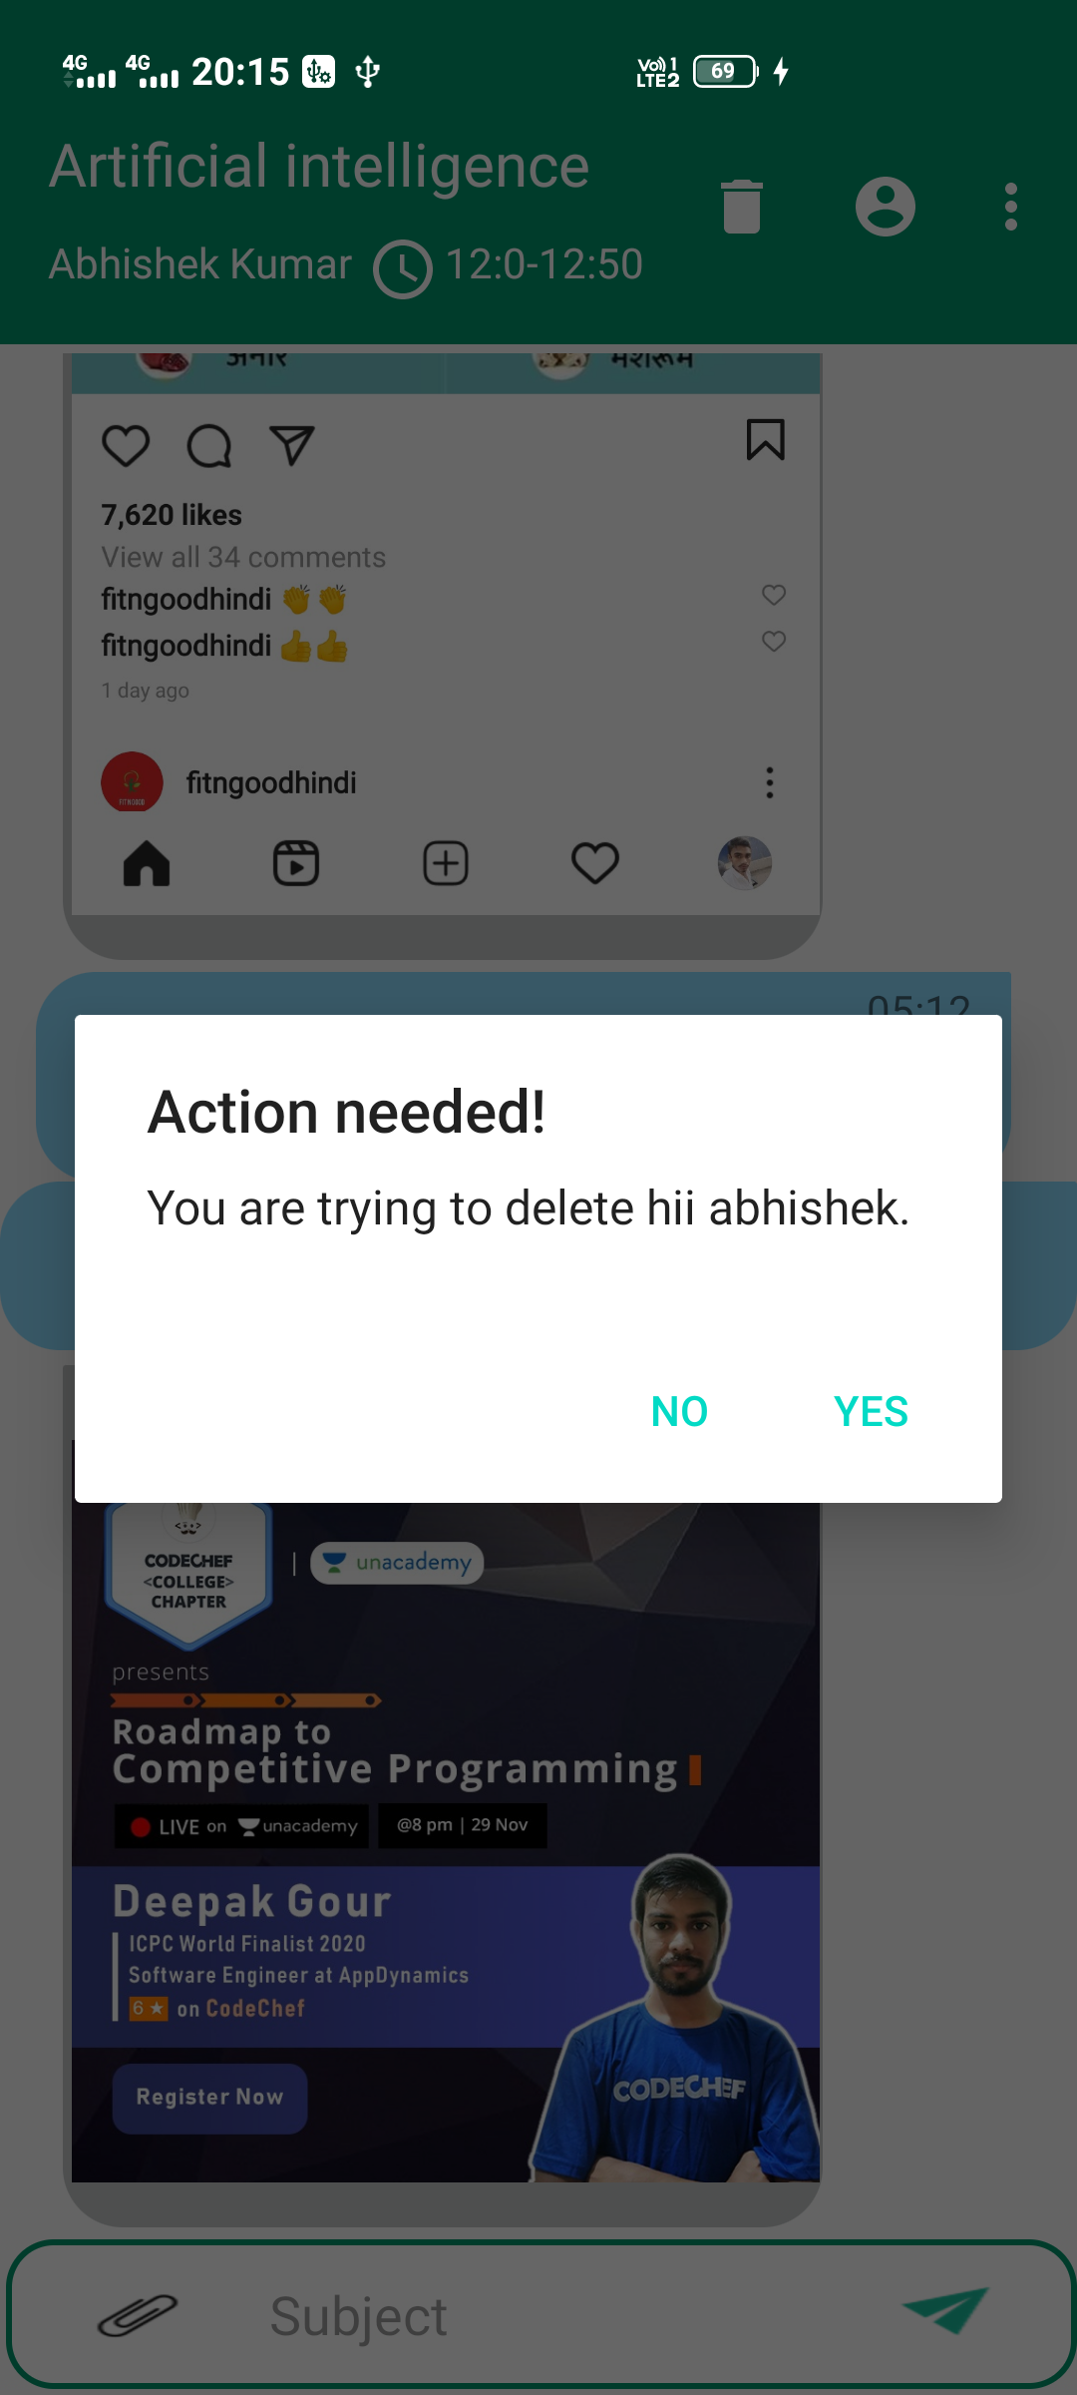
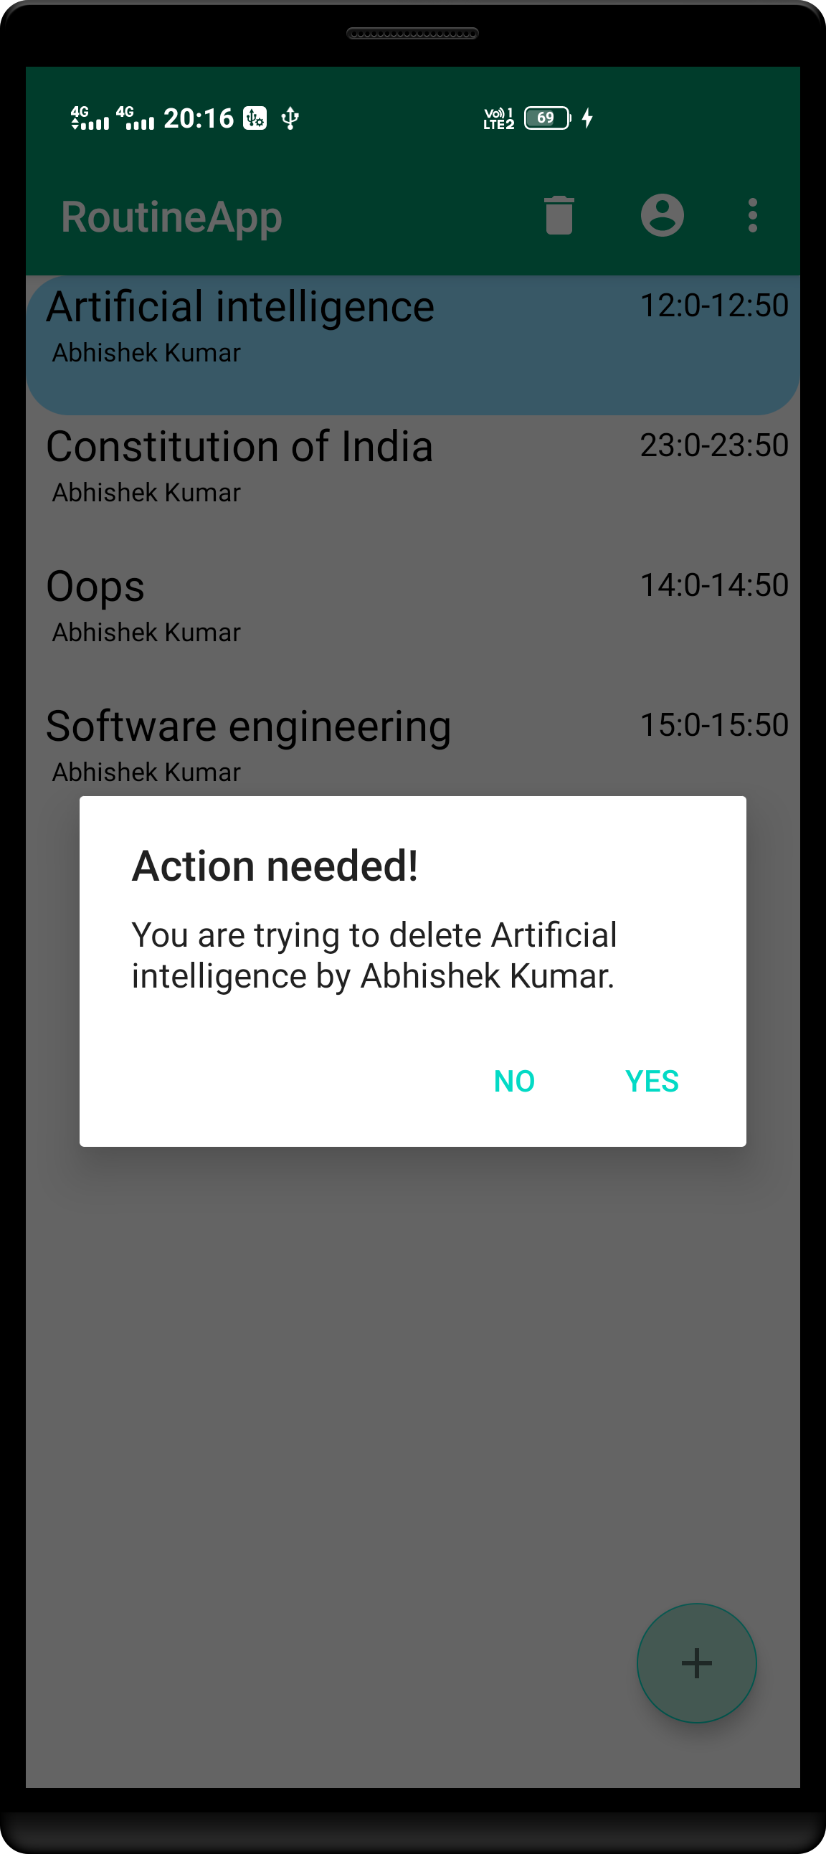
Action for deleting subject
Action for deleting chat

Slide 10
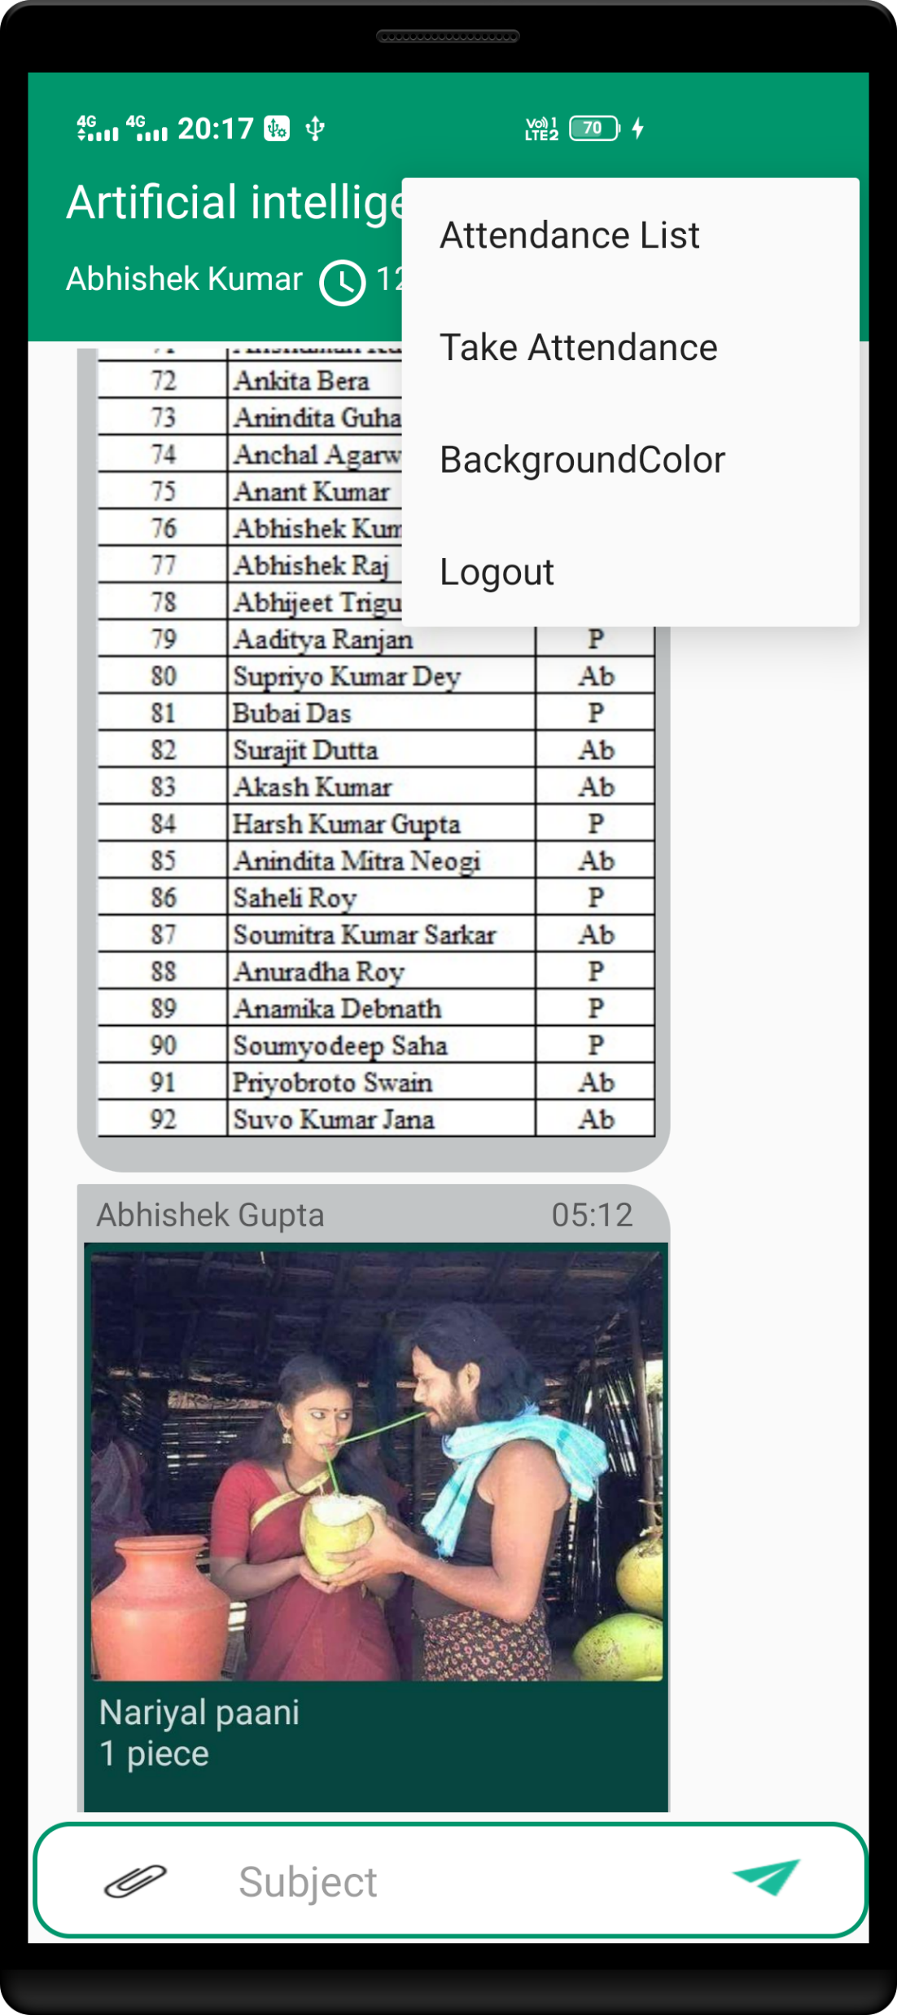
Attendance list tab for adding new student in student attendance list.
Class attendance mark .
Login user chat will be on right side and other will be on left side.

Slide 11
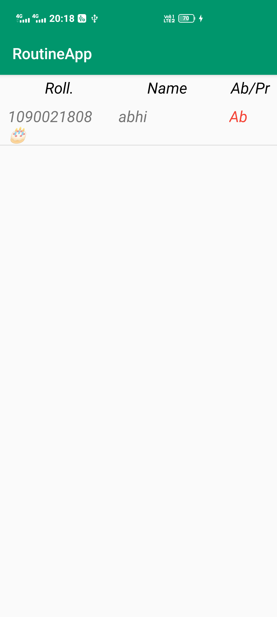
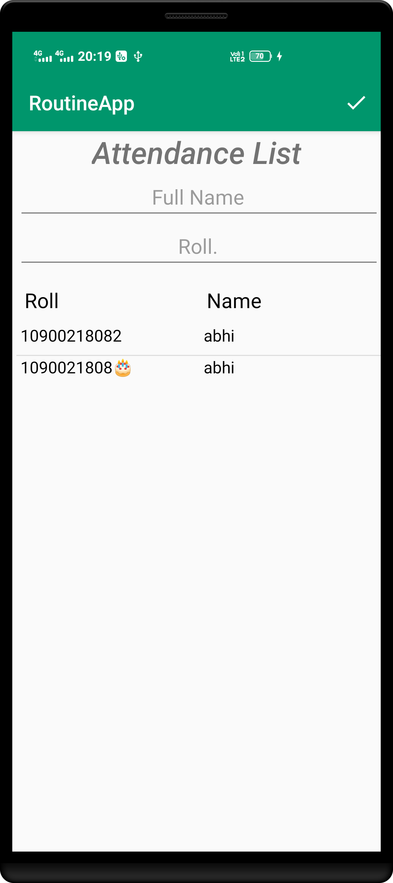

Add new student name
Student roll .
Toggle on student name to make absent or present.
All students will be listed here.

Slide 12
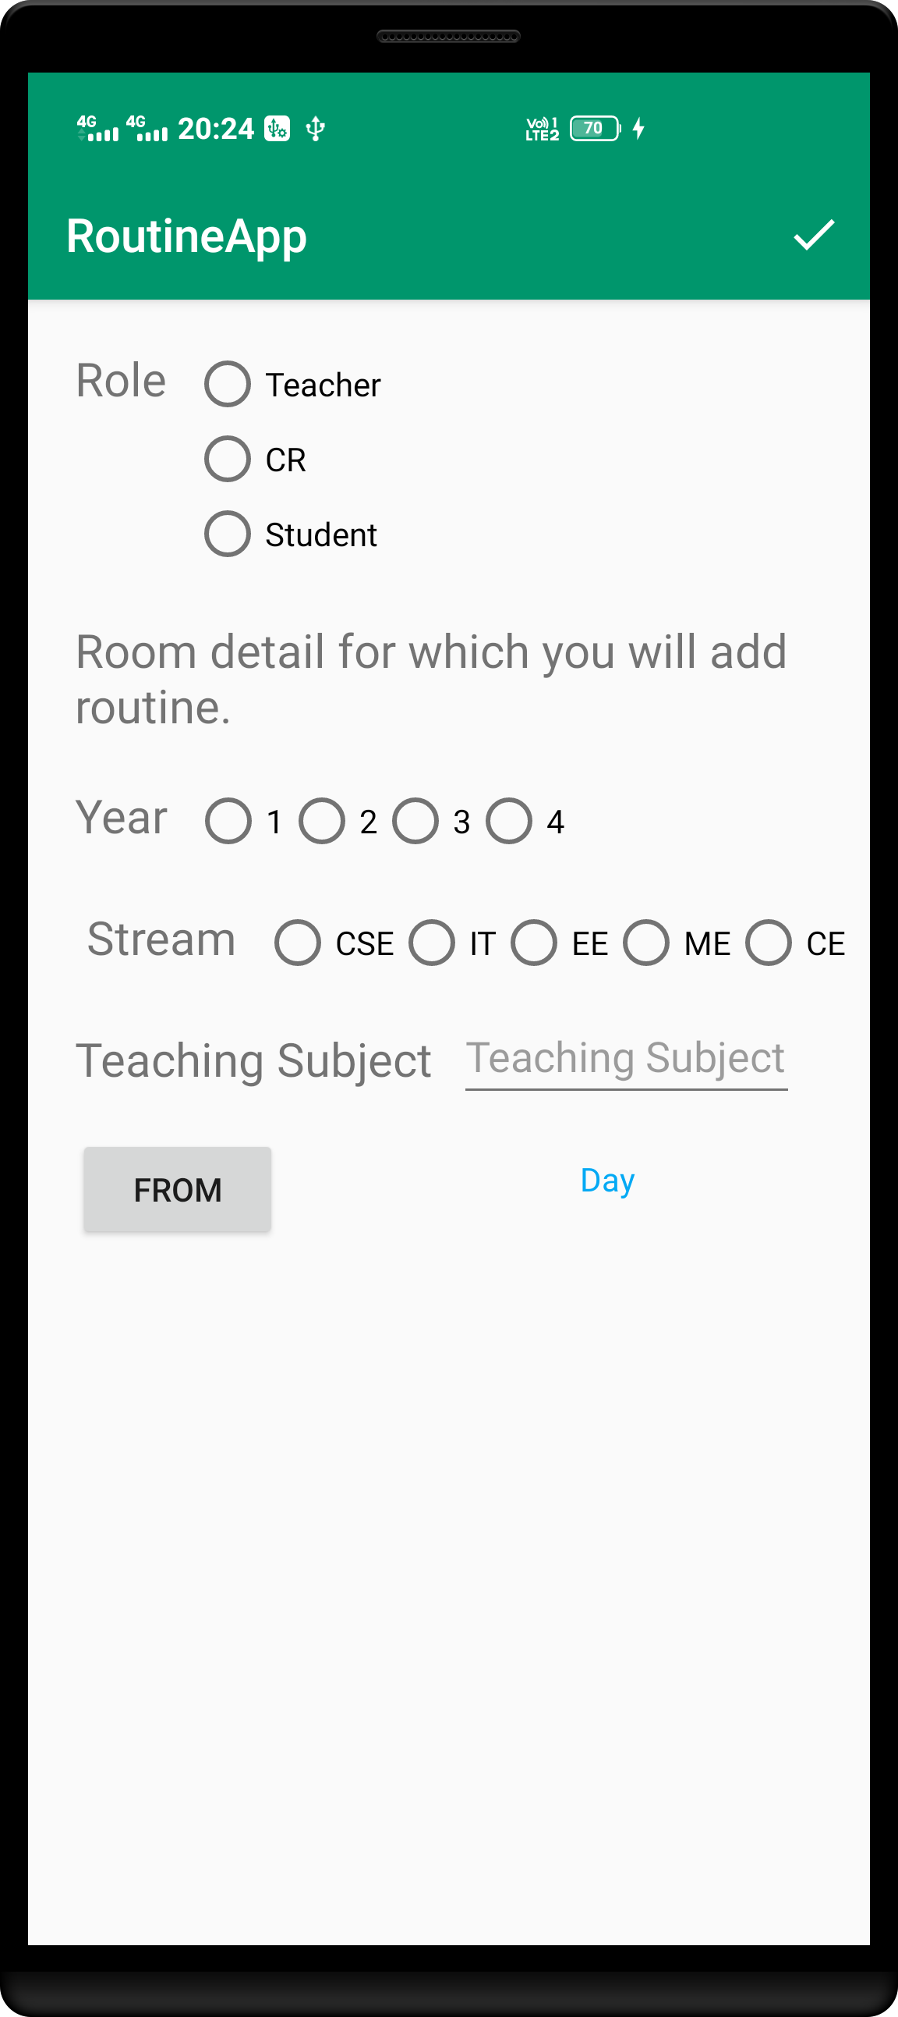
USE
Provide Role, Branch, Year, Subject , Time and day on which class will happen .
Class admin will create a password that will used by student to verify to enter in that particular class.
New subject detail to add in routine.

Slide 13
Platform used
Language used
Firebase Realtime
Firebase Realtime database.
Firebase auth.
Firebase messaging.
Firebase storage.
Android studio.
Java
XML
Sources
Tutorials
Udacity
Google
Stack Overflow
You Tube
Udacity

